Slide 1
Farewell meeting
with International Relations Office & Accommodation Office

Slide 2

Agenda
Accommodation office
International Relations Office
Transcript of records
Documents & certificates
Evaluation/survey
Re-examinations
Departure checklist
Returning home
The Swedish way
Continue to study at JU
Your stay in Jönköping
Present your experience at home
Questions
Fika

Slide 3
Accommodation Office

Slide 4
MOVING OUT AND INSPECTION PROCESS

Slide 5
BOOK THE INSPECTION
University Services housing, follow the instructions in email sent out
Råslätt, instructions and contact staff at Sockertoppen.
Ekhagen, Bäckadal, and Lövingstorp, info email sent out by landlord
Tenhult, contact yvonne@m2gruppen.se
Gräshagen, contact lina@m2gruppen.se
Vilhelmsro and Match House, info email sent out by landlord or contact ulf.svensson@jonkoping.se
Bäckadal, contact the landlord info.backadal@gmail.com

Slide 6
POINTERS
Booking the inspection and returning the key is your responsibility as a tenant
Important to follow the cleaning instructions given
Keys should be returned directly to the landlord if possible, otherwise in a sealed envelope in the black mailbox outside the Caretakers Office. DO NOT leave the key with a friend.
Everyone’s responsibility to make sure that the common areas are clean
Empty fridges and freezers
Clear all debts before leaving
No parties

Slide 7
QUESTIONS?
If you have any questions please submit a case on http://accoservice.ju.se or come visit us on Mondays and Thursdays 1 pm – 3 pm.

Slide 8
GOODBYE!
It’s been a pleasure knowing you all and the Accommodation Office wishes you safe travels back home!

Slide 9
International Relations Office

Slide 10
Transcript of records
Transcripts will be sent to home university approx. in the beginning of September.
You can see your grades in Ladok’s web services.
Grading scale that runs from A to FX. The grades A, B, C, D and E are all passing grades.
Only passing courses will show on the transcript.
Fix (finish) everything before you leave.
Make sure that your transcript includes grades from all courses you attended and passed.
If you turn in a paper after the specified deadline, there is a high risk that the grade for that specific course will not be on your transcript!
Reasons for not receiving a grade!
Contact the teacher if a grade is missing or if there is a mistake when you get your transcript.
You will have acces to your email account, PingPong and Ladok about 6 months after you finish your studies.
If you want a new, updated transcript later on, please contact:
HLK: Daniel.Eriksson@ju.se JTH: Ulrika.Waerland-Gustafsson@ju.se or: incoming.student@ju.se

Slide 11
Documents & certificates
Learning agreement
Other certificates
If you have any documents that need to be signed before you leave Jönköping you can come to Service Center May 16 and 17 between 14.00-16.00.
That’s when we will sign all documents!

Slide 12
Evaluation/survey
SURVEY INCOMING STUDENTS SPRING 2017
Please give yourself some time to reflect and share a few thoughts with us. Jönköping University aims to make your experience at as good as possble. The questionnaire is anonymous but you may add your name in the box at the end of the questionnaire.
- Access PingPong https://pingpong.hj.se/
-Under events you will find the event "Incoming Exchange Students"
-Press start and use the password (small letters): exchange
-Then you will have access to the "survey Incoming students spring 2017

Slide 13
RE-examination
You may do a re-exam at JU
Re-examinations for segment 1, June
Re-examinations for segment 2, August
You have to sign up for re-examinations
Deadline to sign up for your re-exam: 10 days BEFORE the examination date!
Sign-up for your re-exam through Ladok on the web. You will have access to your email account 6 months after you finish your studies

Slide 14
Departure checklist
Clean your accommodation, book inspectiion, pay your bills and return the key
Return all the books you borrowed from the library
Close your bank account
Fill out the survey
Do you still have examinations and assignments to finish?
Avoid last minute / deadlines
Shipping information:
www.eniro.se (Swedish: flyttfirmor)

Slide 15
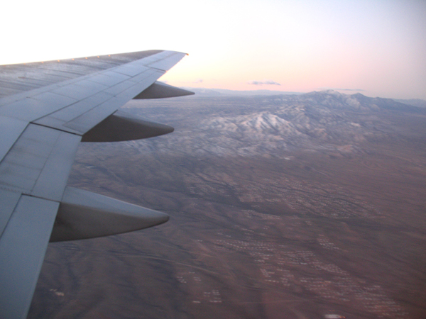
Returning home
Prepare for the re-adjustment process /reversed culture shock)
Allow yourself time
Understand that the familiar might seem different
Allow time for cultural catching up
Keeping in touch
Remain flexible

Slide 16

The Swedish way: You know you’ve been in Sweden too long when…
The first thing you do when entering a bank/post office/pharmacy etc. is to look for a queue number machine
A sharp intake of breath has become part of your words, as has the sound ”ahh”
You associate Friday Afternoon and Saturday morning with a trip to Systembolaget
Silence is fun

Slide 17
The Swedish way: You know you’ve been in Sweden too long when…
Your old habit of being ”fashionably late” is no longer acceptable. You are always on time.
An outside temperature of 9 degrees Celcius is nice weather!
You carry more bottles and cans to grocery store than you bring back.
You are used to having ”fika” in the middle of whatever you are doing.

Slide 18
Continue to study at JU
Summer school, undergraduate programs and master’s programs
All in English
Application information on the web
More information:
https://ju.se/en/study-at-ju/our-programmes.html

Slide 19
Your stay in Jönköping
Your opinion
Accommodation
Differences
Experience
What can we do better?
Please give us your feedback in the survey (info about it in email or on facebook)

Slide 20
Present your experience at home
Tell your friends/ inspire other students
Presentations
International activities at your home university
Contact person

Slide 21
Questions?

Slide 22

Finally…
Thank you for everything!
Come and say good bye!
Good luck with everything!
You are always welcome back to Jönköping !

